Slide 1



Developed By
Dharmil K. Shah (1718034)

Slide 2


ShareCal
Developed By:
Dharmil K. Shah (1718034)
Guided By:
Mr.Bhavesh Hariyani
Submitted To:
Shree Swaminarayan College of Computer Science
Gurukul Campus, Sardarnagar, Bhavnagar
(Affiliated to M.K. Bhavnagar University)

Slide 3
Introduction
- The website is used to save and share your events and schedule mails.
- User will create an account through OTP and calendar will be provided.
- User can find friend and can have chat with them in personal or in group.
- User can also share events with friends or group of friends.
Now days people are having tight/busy schedule/days. It's common to forget to save and/save some important events or occasions. Easy way is to store/save your upcoming event details and information. This site will provide service to store and also share events with friends and family and we will remember and notify you upon your event occurrence.

Slide 4
Purpose & Scope
Existing system/apps will let you save events but you cannot share it with your contacts.
In addition , you can also have conversation with your contacts and also can schedule mails to send them on particular time.

Slide 5
Hardware & Software Requirement
Developer side :
Component | Description
Processor | 64 bit Intel Celeron, 1.10GHz
Ram | 4 GB
Hard Disk | 1 TB
Operating System | Windows 10
Server | Xampp Server(3.2.2)
Front-end | PHP, HTML, CSS, Javascript, Jquery
Back-end | MySQL
Editor | Brackets
Browser | Google Chrome

Slide 6
Features & Facilities
User :
Store Events
User can store events with details.
Friends
User can find their friends registered on site.
Chatting
User can chat with friends.
Groups
User can create groups and add members and add group events and chat in group.
Mails
User can schedule mails.

Slide 7
Features & Facilities
Admin :
Admin can do all things that user can do on site. Additionally admin can check status of mail sending script and handle that.

Slide 8
Data Flow diagram
Data flow diagram (DFD) is one of the most commonly used
graphical tools for representing the high level functionality of a
system. The process shape, which is the most important components.
In a DFD, represents the part of the system that transform certain
(data) input into outcome

Slide 9
Data Flow diagram
There are different type of notations are use for diagram.
Symbol | Name
 | External Entity
 | Process
 | Data Flow
 | Data store

Slide 10
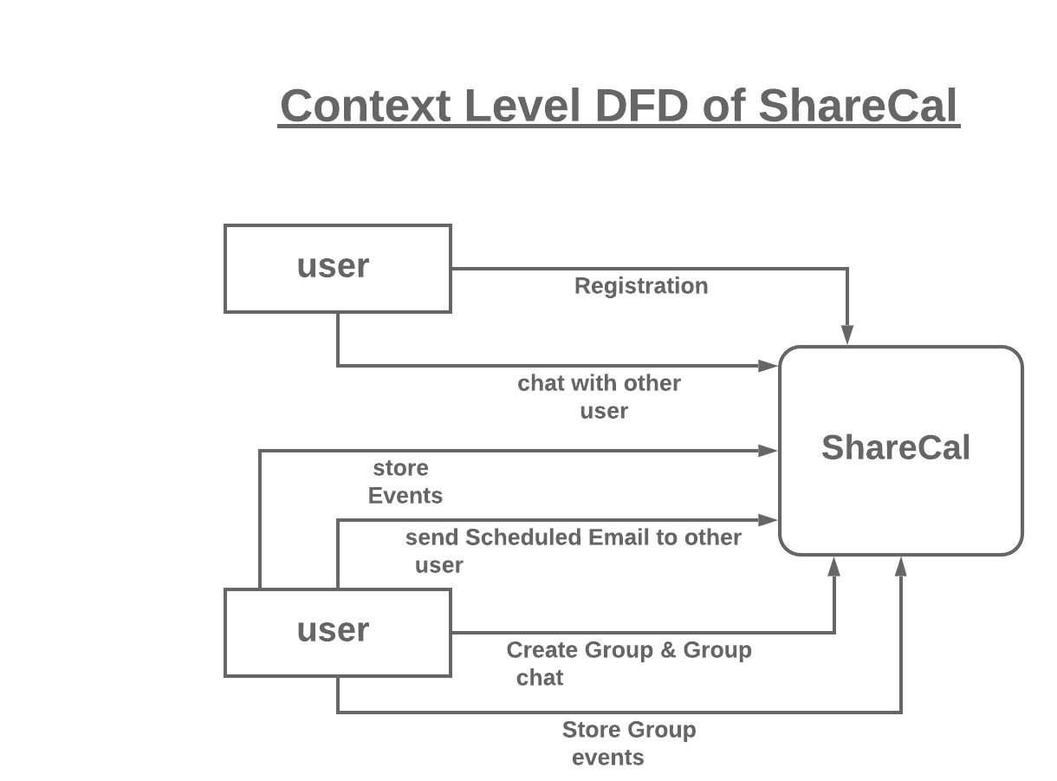
Data Flow diagram

Slide 11
Entity Relationship Diagram
An entity relationship diagram (ERD) shows the relationships of entity sets stored in a database.
An entity in this context is an object, a component of data.
An entity set is a collection of similar entities. These entities can have attributes that define its properties. By defining the entities, their attributes, and showing the relationships between them, an ER diagram illustrates the logical structure of databases.
ER diagrams are used to sketch out the design of a database

Slide 12
Entity Relationship Diagram
There are different type of notations are use for diagram
Name | Symbol | Description
Rectangle |  | Representing Entity Set
Oval |  | Representing Attributes
Diamond |  | Representing relationships among entity sets
Line |  | Links attributes to entity sets And entity sets to relationship

Slide 13
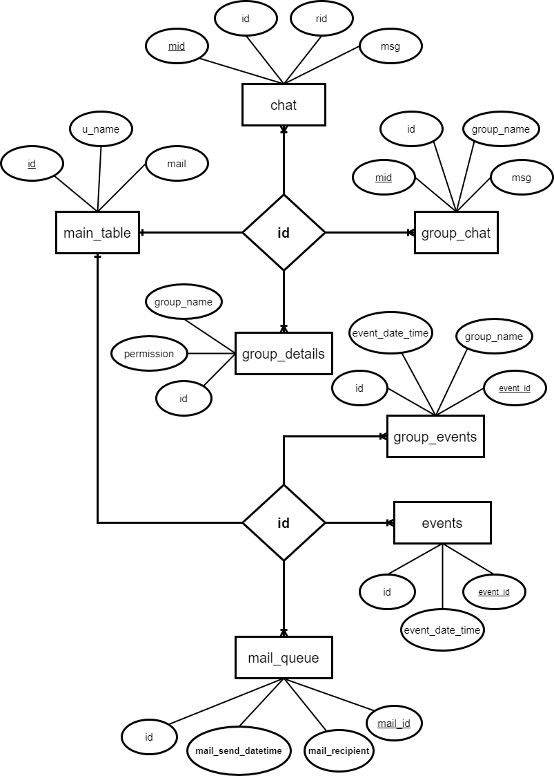
E n t i t y
R e l a t i o n s h i p
D i a g r a m

Slide 14
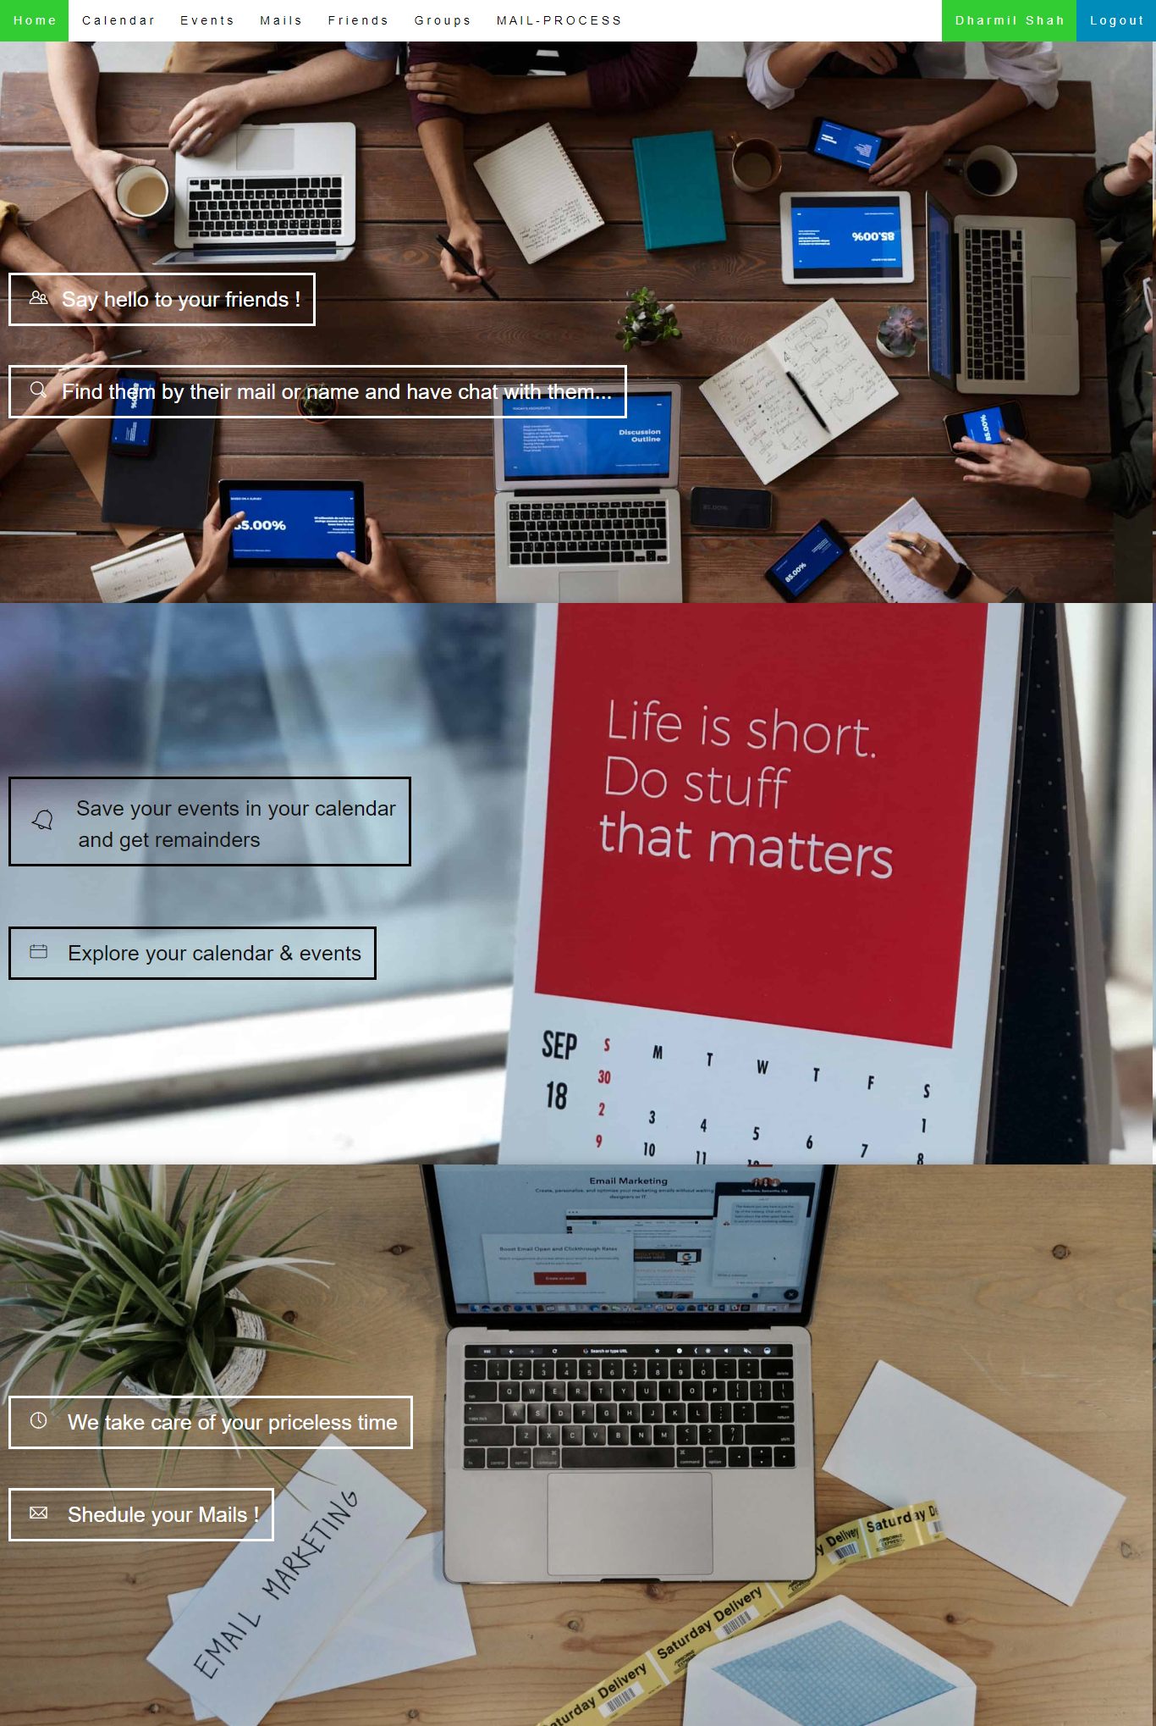
Screen Shots
Homepage

Slide 15
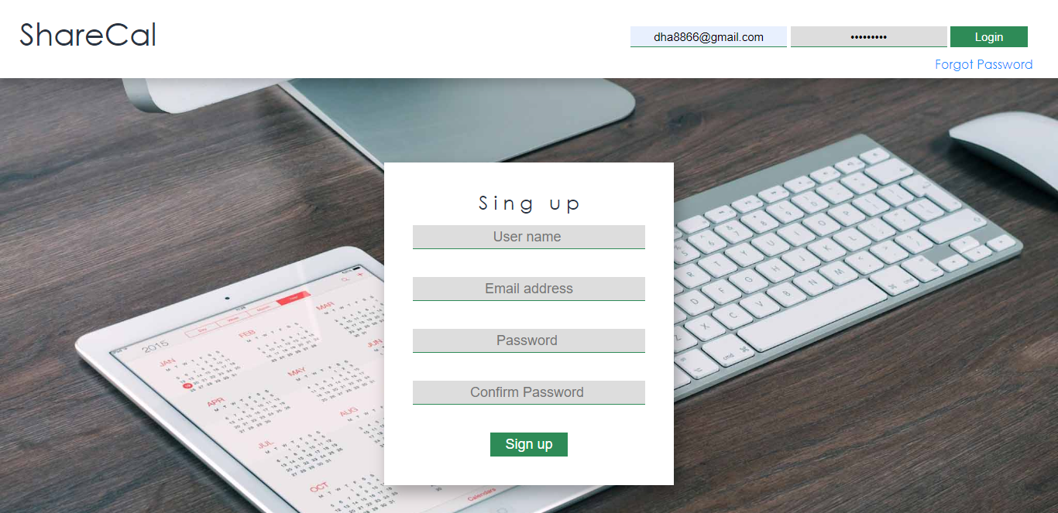
Screen Shots
Login/Signup Page

Slide 16
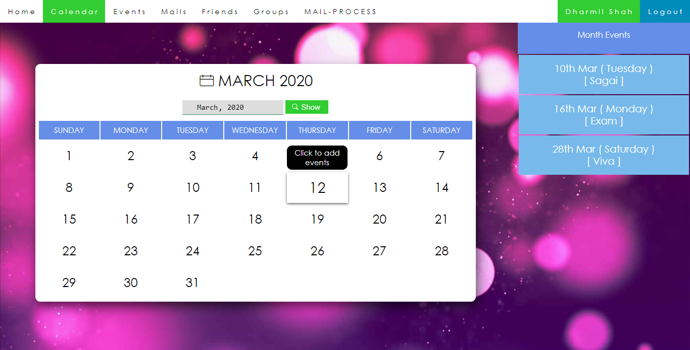
Screen Shots
Calendar

Slide 17
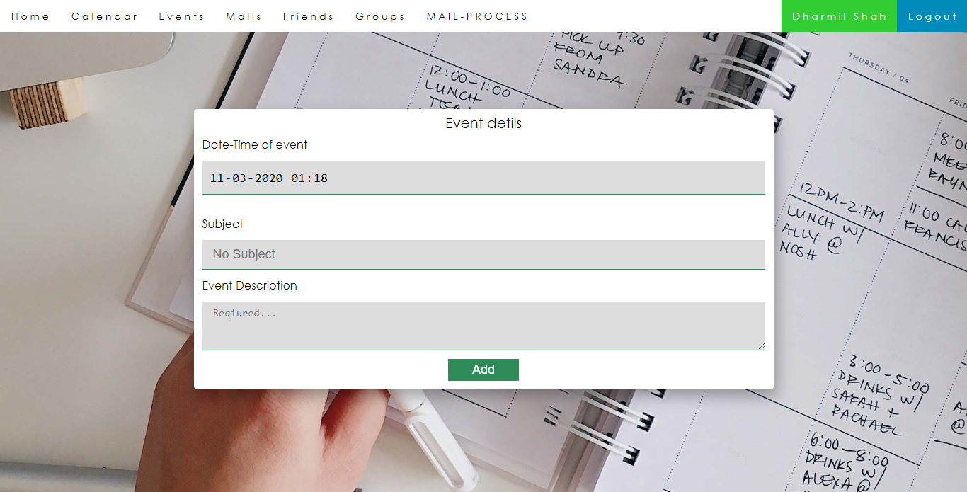
Screen Shots
Add event

Slide 18
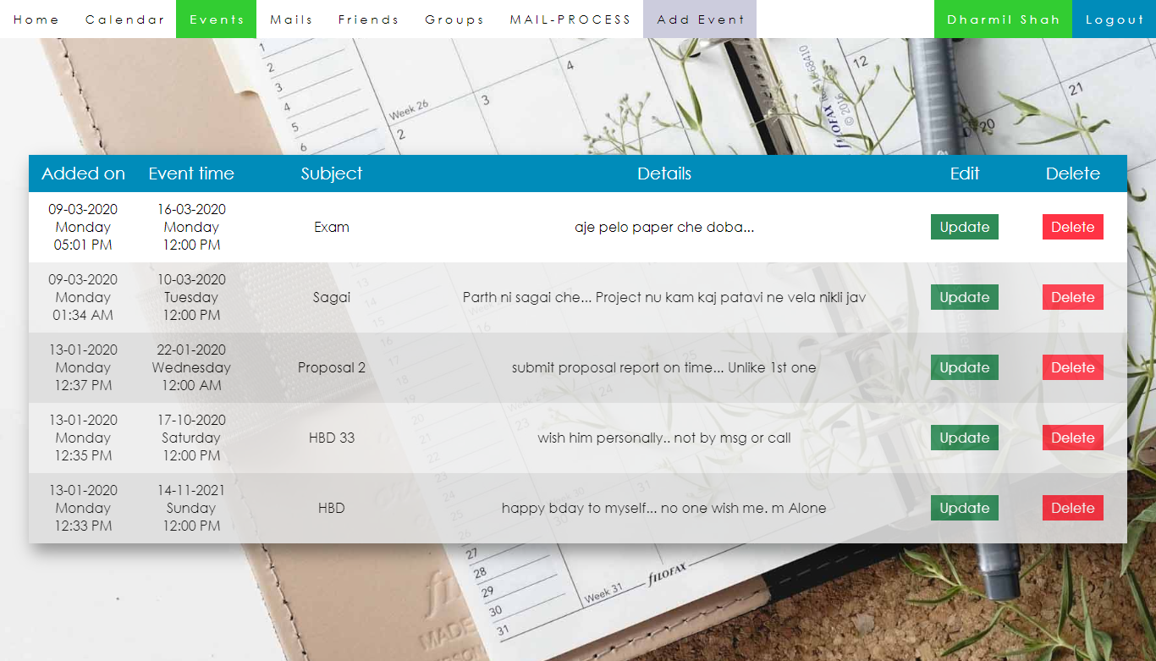
Screen Shots
Show events

Slide 19
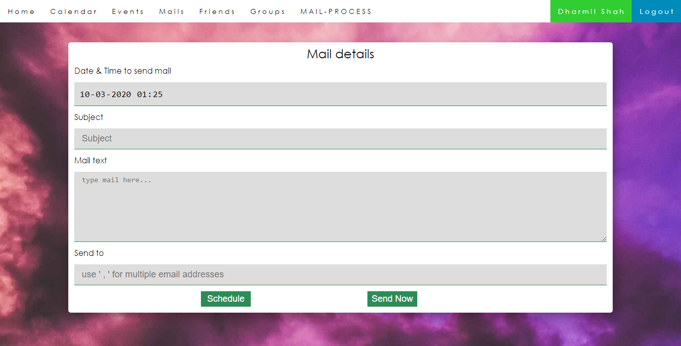
Screen Shots
Schedule mail

Slide 20
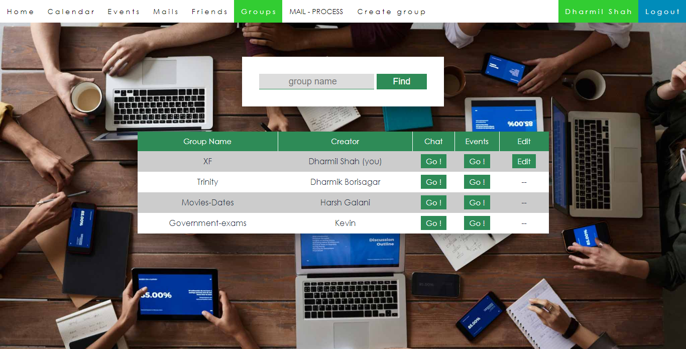
Screen Shots
Groups

Slide 21
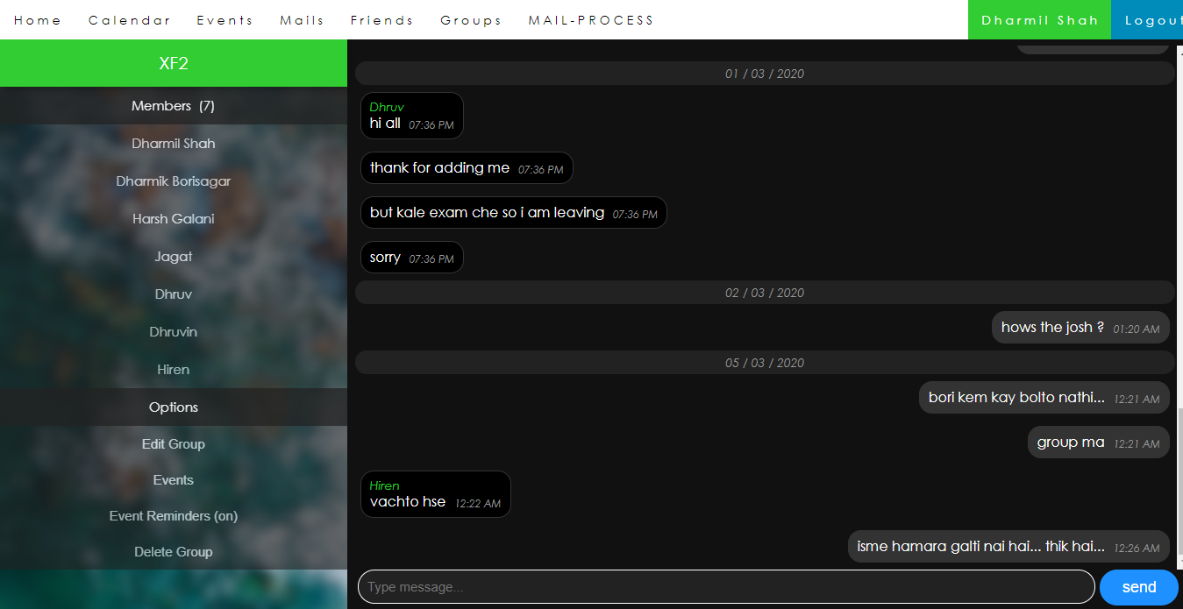
Screen Shots
Group Chat

Slide 22
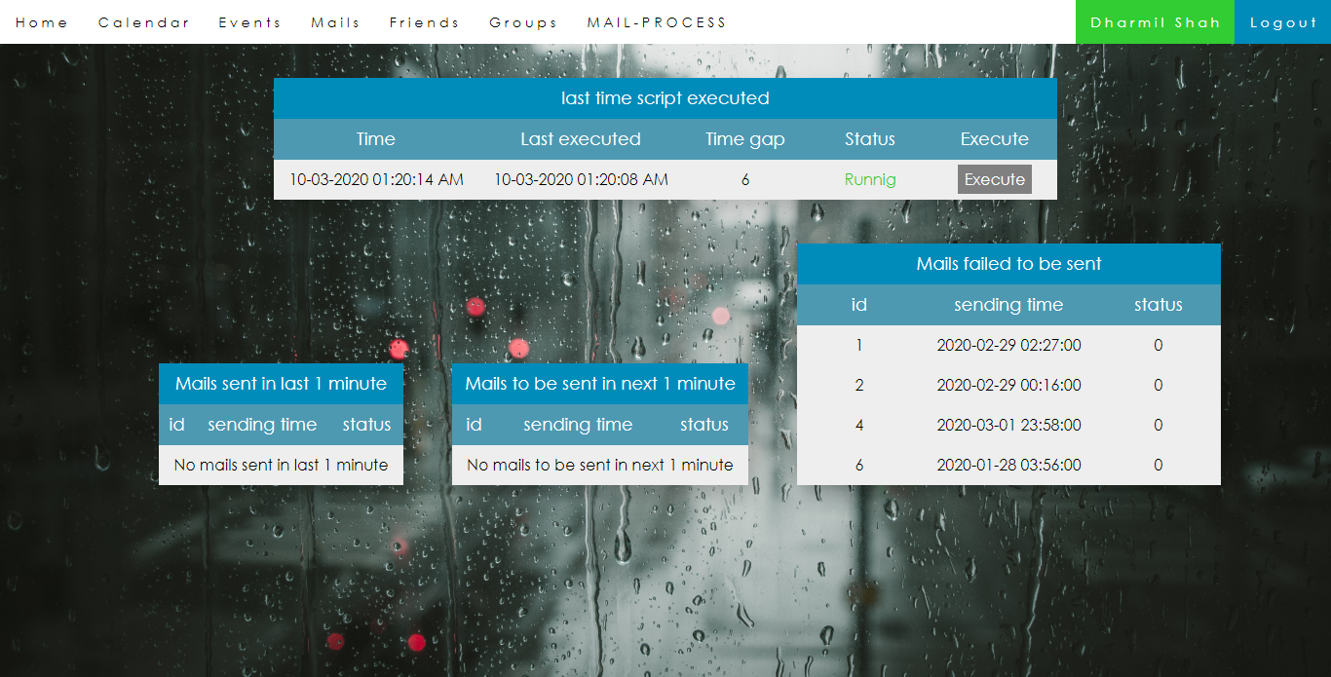
Screen Shots
Mail process

Slide 23
Future Enhancement
As opposed to our current development, a few more functionality can be added to further expand the project.
Providing the more facility and operations to admin users. Like deleting or blocking users and groups from user’s reports.
Adding more facilities for users like notifications of chat or any other activities.
We can add functionality to make group public so any user can search and join it. Like public channels on telegrams.
More functionality for users like sending attachments with mail, user’s profile picture, sending pics and emoji in chatting etc.

Slide 24
Conclusion
In the beginning the project seemed to be just one another subject that we needed to pass in order to get a through our semester. But with passing time and with each passing day (even nights!), we found the development of this project became a great learning process.
Not only the project taught us how to analyze and code any software but it also managed to show me important resource management skills. Also teach us time management in within deadline is reach so it is a part of management skill and important things for future.
We had to complete the project in time and budget. It was very important that we got proper information from the end-users in order to provide them with a fully functional and simple enough to understand system. That helped us to learn how to deal with people of different temperament and opinions.
All in all this entire project has prepared us fully for what we are going to face in the IT field in future.

Slide 25
Thank You !

